Slide 1
Spring MVC Errors and Sloution

Slide 2
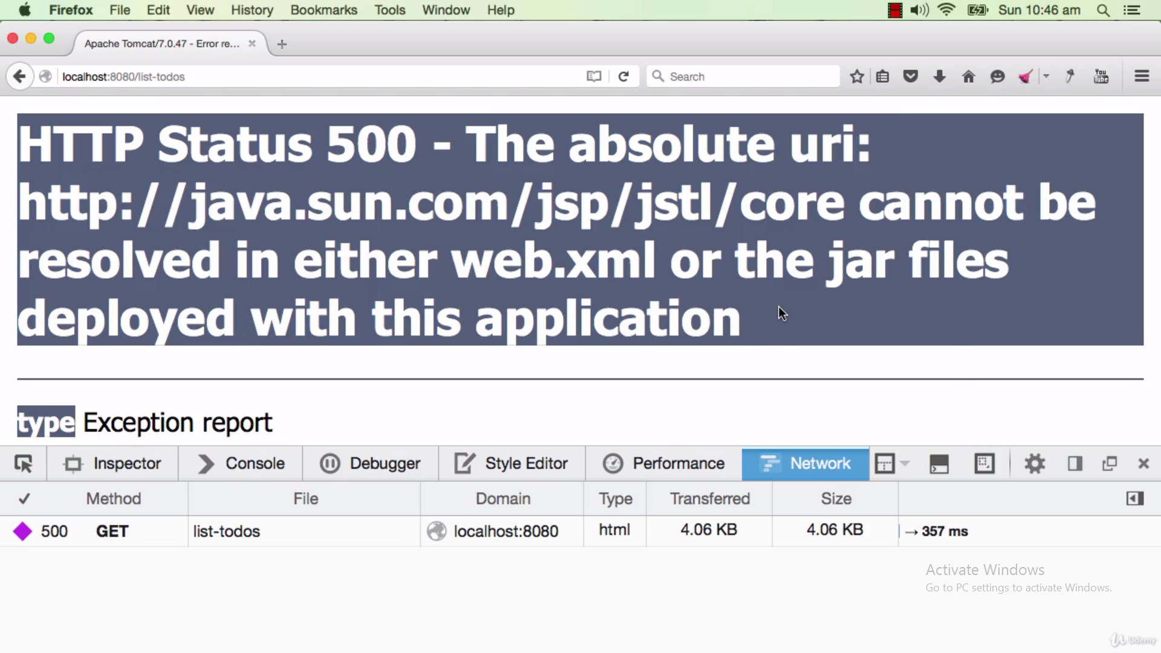
1) To Fix this error we need to add jstl dependency in pom.xml

Slide 3
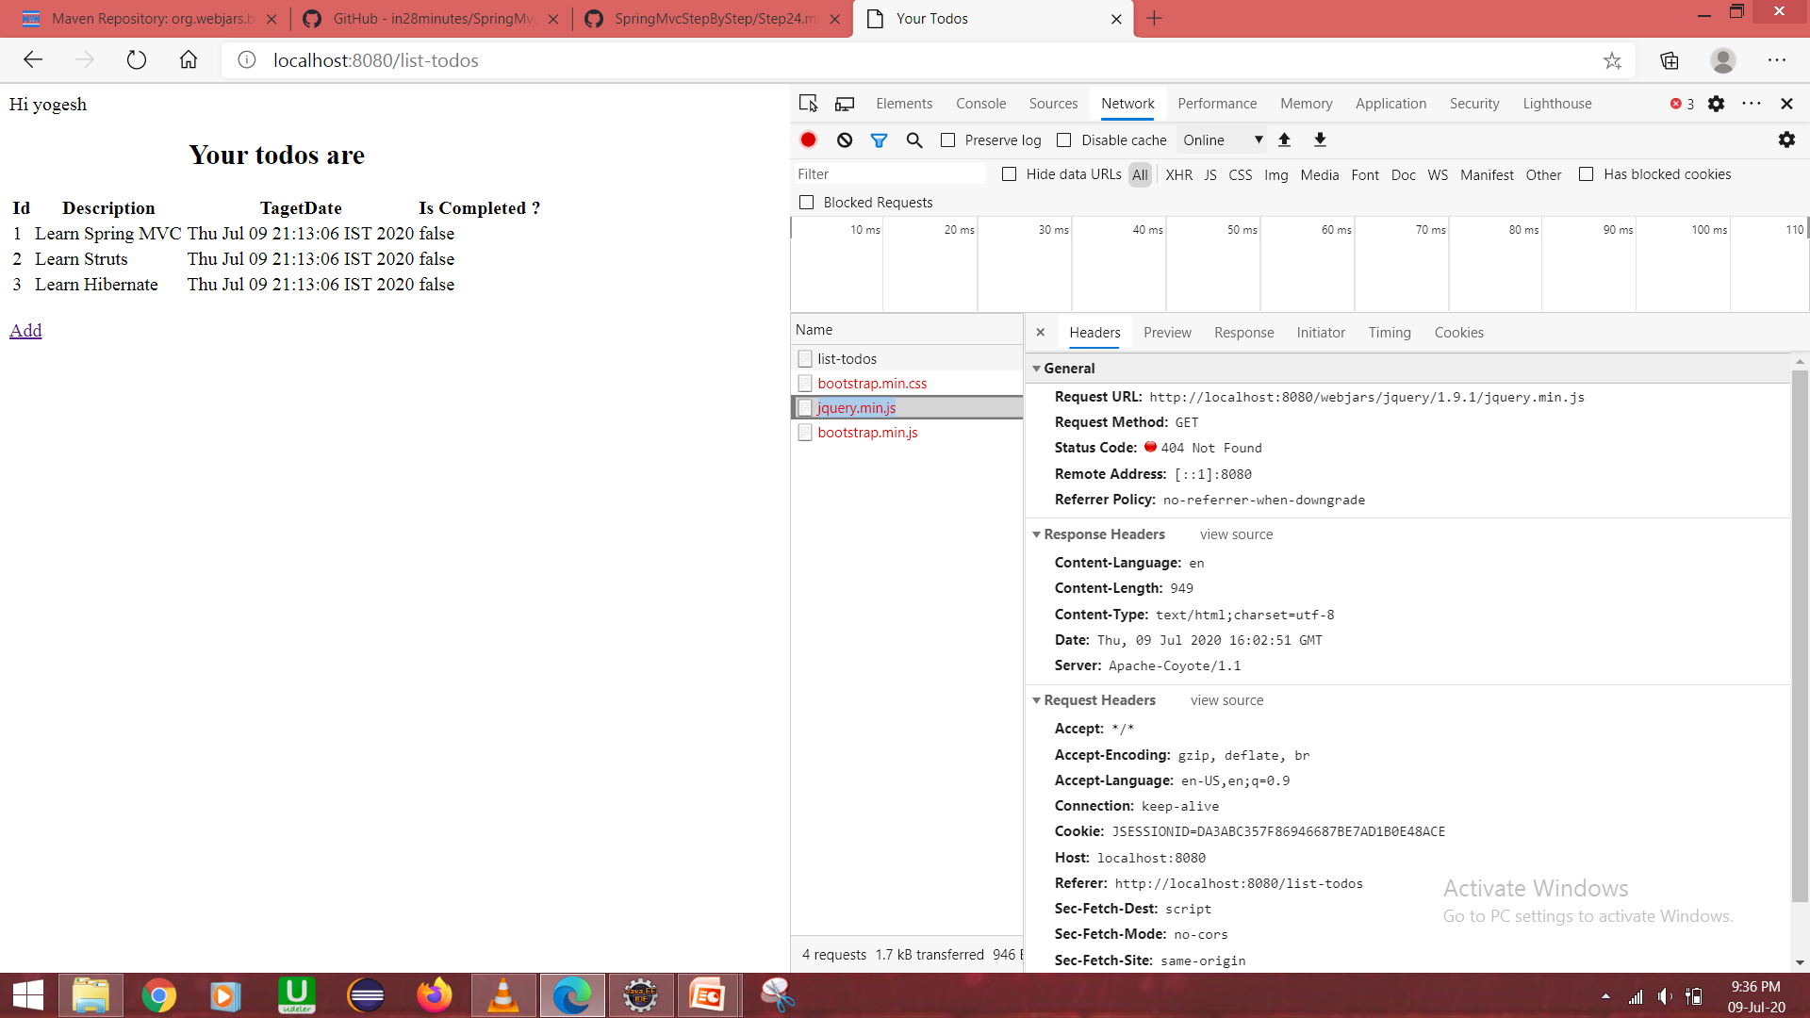
2) Here the spring frame work is not able to find bootstrap.min.css, jquery.min.js, jquery.min.js Reason is they are inside resouce sub folders. we need use these jar from inside of this folders for that we need to add resource mapping <mvc:resources mapping="/webjars/**" location="/webjars/"/>. So that spring frame work will know the location of web jars and make use of those jars.

Slide 4
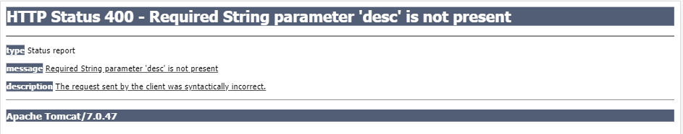
There is parameter called desc in the controller method but we are not using that parameter in any request. If you want to resolve this error either add desc in cotroller method or delete @RequestParam String desc from the controller method.

Slide 5
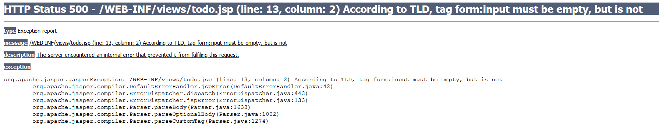
We have use Spring tags for form , instead of normal froms.
We have to make sure we closed tags perfectly or not.
<form:input some code />, for this we no need to close explicitly like this </form:input>

Slide 6
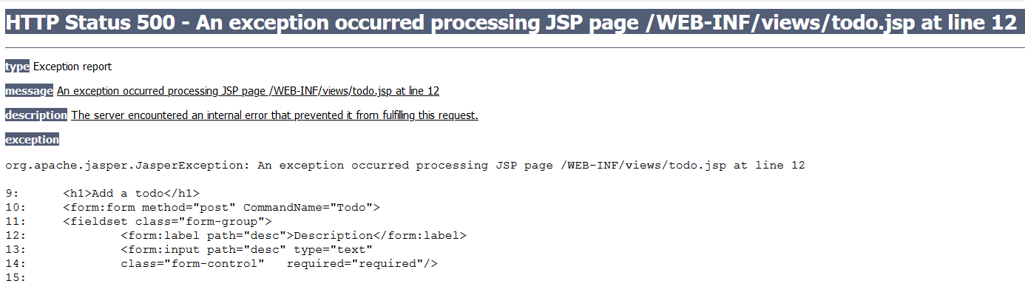
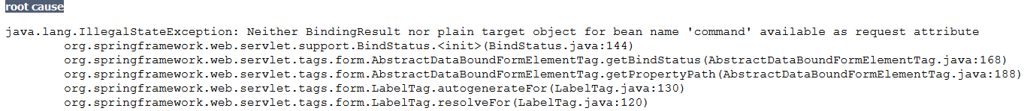
If want to use binding we have to make the object available earlier. For that we need to create a model in GET method. And need to use model.addAttributes() method there.
The constructor should be same as present in Todo class.

Slide 7
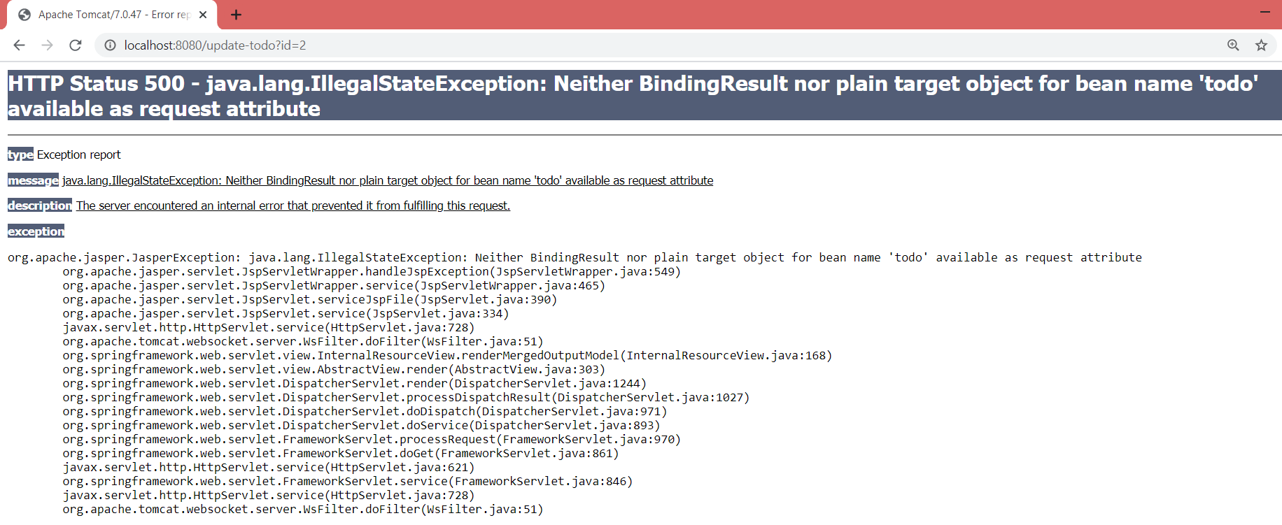
If we are using same jsp for add todo and update todo, we should not use model.clear() method in TodoController GET method, Because it never pass the data, when we are accessing it for the next time.

Slide 8
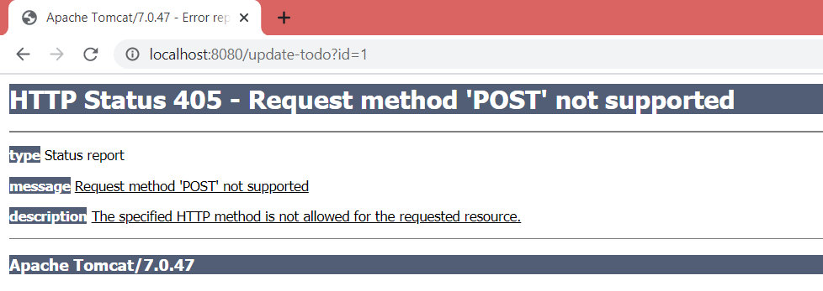
We are getting this error, Because we have’t implemented the POST method, for handling the update. When ever user is submitting something like a login from, there we have to implement the POST method there.

Slide 9
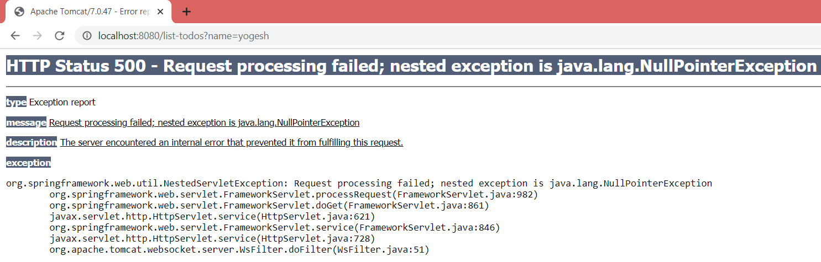
Here we are trying to update a todo based on id, but in our todo.jsp we put values only for desc. So other than desc all the attributes will not be available while we are updating todo.
But we have to implement it for id, So for that we have to use form, <form:hidden>, this will create a hidden variable. Hidden are something that we don’t want to see, but I those values to be returned.
So theses variables will be available from now on the screen when we post something .

Slide 10
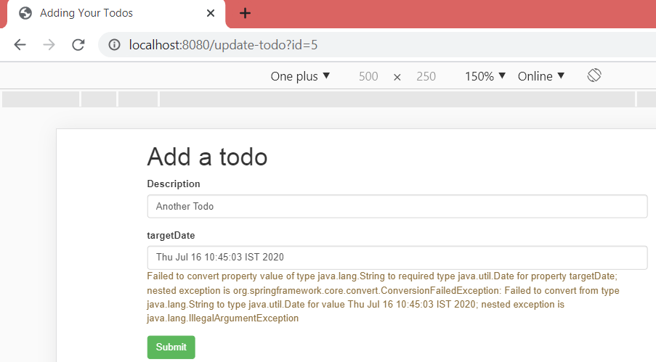
It is a validation error, To fix this we add @InitBider annotation, also define a method where spring has to use a particular date format so when ever spring load up it takes that format only.

Slide 11
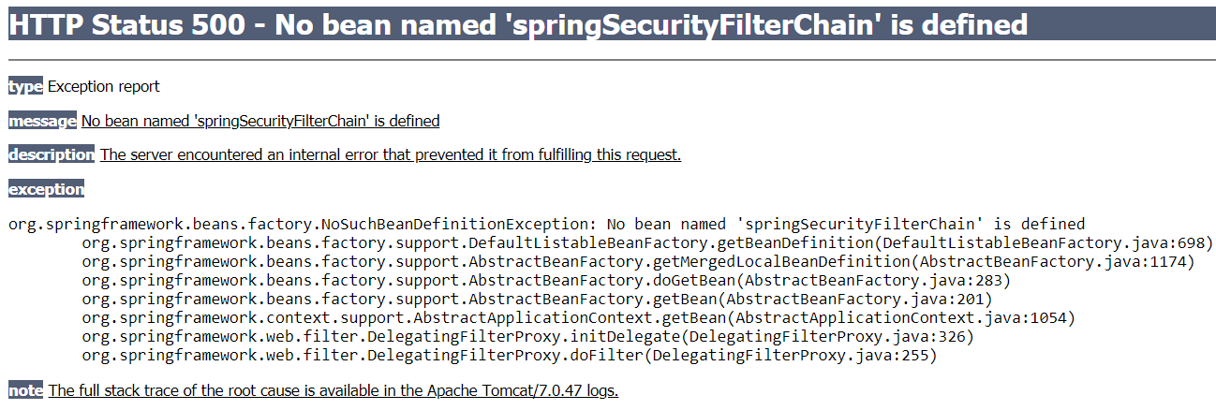
We added a springsecurityFilterChain in web.xml, but we hav’t given the bean location. ie we need to add component scan for the new class SecurityConfiguration(contains bean definition for springSecurityFilterChain) in todo-servlet.xml

